Slide 1
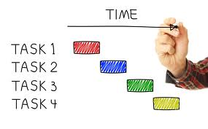
CSG2344 Project Methods and Professionalism
Project Planning -Time
How good or bad are we at estimation?
ECU Copyright 2015 – CSG 2344 School of Computer and Security Science

Slide 2

Lecture objectives
Time planning processes and outputs
Estimation techniques
Schedule development
ECU Copyright 2015 – CSG 2344 School of Computer and Security Science

Slide 3
How good or bad are we at estimation?
For those of you who have written a program before – Java, C++, Access whatever, think of the best and worst scenario.
  How close was your best attempt compared to your initial estimate?
  How bad was your worst?
ECU Copyright 2015 – CSG 2344 School of Computer and Security Science

Slide 4

Importance of Project Schedules
Managers often cite delivering projects on time as one of their biggest challenges.
- Schedule issues are the main reason for conflicts on projects, especially during the second half of projects.
- Time has the least amount of flexibility; it passes no matter what happens on a project.
ECU Copyright 2015 – CSG 2344 School of Computer and Security Science

Slide 5

Project Time Management as defined in PMBOK
Project time management: involves the processes required to ensure timely completion of a project.
  Activity definition
  Activity sequencing
  Activity duration estimation
  Schedule development
  Schedule control
ECU Copyright 2015 – CSG 2344 School of Computer and Security Science

Slide 6
Estimation Techniques
Guesstimating
Top-Down
Bottom Up
Analogous Estimates (Past experiences)
Delphi Technique
Software Engineering approaches
Time Boxing – the Agile Method
ECU Copyright 2015 – CSG 2344 School of Computer and Security Science

Slide 7

Project Estimation
Guesstimating
  Based on feeling not facts
  Not a good method for estimating but often used by inexperienced project managers
ECU Copyright 2015 – CSG 2344 School of Computer and Security Science

Slide 8
Project Estimation
Top-Down Estimating
  Top & middle managers determine overall project schedule
  Lower level managers are expected to breakdown schedule/budget estimates into specific activities (WBS)
  Often couched in terms of what a project should cost and how long it should take as decreed by a member of top management
  May be a political response rather than a realistic one but sometimes projects have to meet deadlines in the business environment (e.g. government set the date for GST)
ECU Copyright 2015 – CSG 2344 School of Computer and Security Science

Slide 9
Project Estimation
Bottom-Up Estimating
  Most common form of project estimation
  Schedules & budgets are constructed from the WBS
  Starts with people who will be doing the work
  Schedules & budgets are the aggregate of detailed activities & costs
ECU Copyright 2015 – CSG 2344 School of Computer and Security Science

Slide 10
Project Estimation
Analogous estimating
  based on similarity between current projects and others.
  Use information from previous, similar projects as a basis for estimation
  Why is this problematic for Software Development?....
ECU Copyright 2015 – CSG 2344 School of Computer and Security Science

Slide 11
Project Estimation
Delphi Technique
  Very effective but very expensive
  Involves multiple, anonymous experts
  Each expert makes an estimate
  Estimates compared
    - If close, can be averaged
    - Else do another iteration until consensus is reached
ECU Copyright 2015 – CSG 2344 School of Computer and Security Science

Slide 12


Project Estimation - Software Engineering Approaches
Lines of Code (LOC)
Function Points
COCOMO
ECU Copyright 2015 – CSG 2344 School of Computer and Security Science

Slide 13
Project Estimation - Software Engineering Approaches
COCOMO computes software development effort (and cost) as a function of program size. Program size is expressed in estimated thousands of source lines of code (SLOC)
COCOMO applies to three classes of software projects:
Organic projects - "small" teams with "good" experience working with "less than rigid" requirements
Semi-detached projects - "medium" teams with mixed experience working with a mix of rigid and less than rigid requirements
Embedded projects - developed within a set of "tight" constraints. It is also combination of organic and semi-detached projects.(hardware, software, operational, ...)
ECU Copyright 2015 – CSG 2344 School of Computer and Security Science

Slide 14
Software Engineering Metrics and Approaches
Lines of Code (LOC)
  An often used metric for determining the size of the project
  But it is the most controversial
    Count comments?
    Declaring variables?
    Efficient code vs. code bloat
    Language differences
    Easier to count afterwards than to estimate before programming begins
ECU Copyright 2015 – CSG 2344 School of Computer and Security Science

Slide 15
Function Point Analysis
Independent of the Technology
IFPUG standards (www.ifpug.org)
5 Primary Elements (of varying complexity)
  Inputs
  Outputs
  Inquiries
  Internal Logical Files eg each entity in an ERD
  External Interface File
Adjustment for system characteristics
ECU Copyright 2015 – CSG 2344 School of Computer and Security Science

Slide 16
What do Function Points mean?
A measure of system size
Transform into development estimates
  Eg a programmer can produce x function points per week or month
Requires commitment to metric collection over time
Comparison between organisations
ECU Copyright 2015 – CSG 2344 School of Computer and Security Science

Slide 17
What Is the Best Way to Estimate IT Projects?
Use more than one technique for estimating
If estimates from different techniques is close, average them
Adjust estimate based on experience
Negotiation may lead to unrealistic estimations
ECU Copyright 2015 – CSG 2344 School of Computer and Security Science

Slide 18
Creating the Activity Definition
Activity list
  From WBS
  is a tabulation of activities to be included on a project schedule.
Activity attributes
  Further info for WBS dictionary
  provide schedule-related information about each activity, such as predecessors, successors, logical relationships, leads and lags, resource requirements, constraints, imposed dates, and assumptions related to the activity.
ECU Copyright 2015 – CSG 2344 School of Computer and Security Science

Slide 19
Creating a Milestone List
A milestone is a significant event in a project.
It often takes several activities and a lot of work to complete a milestone, but the milestone itself is like a marker to help identify necessary activities.
There is usually no cost or duration for a milestone.
Project sponsors and senior managers often focus on major milestones when reviewing projects.
Sample milestones for many projects include:
  Sign-off of key documents
  Completion of specific products
  Completion of important process-related work, such as awarding a contract to a supplier

Slide 20
Activity Sequencing
Determining the relationships or dependencies between activities.
A dependency or relationship relates to the sequencing of project activities or tasks.
  For example, does a certain activity have to be finished before another one can start?
  Can the project team do several activities in parallel?
  Can some overlap?
Activity sequencing has a significant impact on developing and managing a project schedule.
ECU Copyright 2015 – CSG 2344 School of Computer and Security Science

Slide 21
Network Diagrams
Network diagrams are the preferred technique for showing activity sequencing.
  The precedence diagramming method (PDM) is a network diagramming technique in which boxes represent activities. These are now more widely used
  In the activity-on-arrow (AOA) approach, or the arrow diagramming method (ADM), activities are represented by arrows and connected at points called nodes (starting and ending point of an activity) to illustrate the sequence of activities
ECU Copyright 2015 – CSG 2344 School of Computer and Security Science

Slide 22
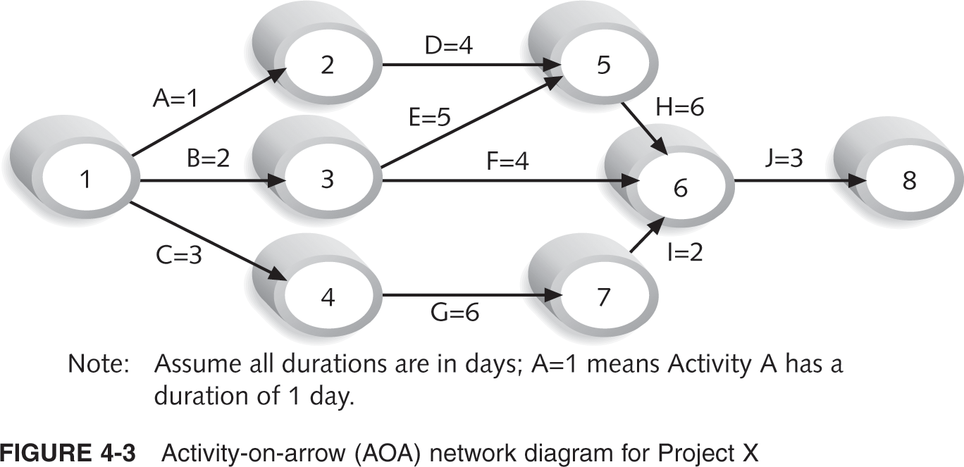
Activity-on-Arrow (AOA) Network Diagram for Project X
ECU Copyright 2015 – CSG 2344 School of Computer and Security Science

Slide 23
Discrete, Range, and Three-Point Estimates
Duration estimates are often provided as discrete estimates, such as four weeks.
A range estimate might be between three and five weeks.
A three-point estimate is an estimate that includes an optimistic, most likely, and pessimistic estimate, such as three, four, and five weeks.
ECU Copyright 2015 – CSG 2344 School of Computer and Security Science

Slide 24
Program Evaluation and Review Technique (PERT)
Program Evaluation and Review Technique (PERT) is a network analysis technique used to estimate project duration when there is a high degree of uncertainty about the individual activity duration estimates.
PERT weighted average =
optimistic time+4×most likely time+ pessimistic time
6
Example: PERT weighted average =
(1 workday+4×2 workdays+9 workdays)/6 = 3 workdays
Instead of using the most likely time of two workdays for this task, you’d use three workdays with a PERT estimate.
ECU Copyright 2015 – CSG 2344 School of Computer and Security Science

Slide 25
Schedule Development
Schedule development
  uses the results of all the preceding estimation processes to determine the start and end dates of all project activities
The project schedule
  is often shown on a Gantt chart, listing project activities and their corresponding start and finish dates in a calendar format.
The ultimate goal of schedule development is to create a realistic project schedule that provides a basis for monitoring project progress for the time dimension of the project.
ECU Copyright 2015 – CSG 2344 School of Computer and Security Science

Slide 26
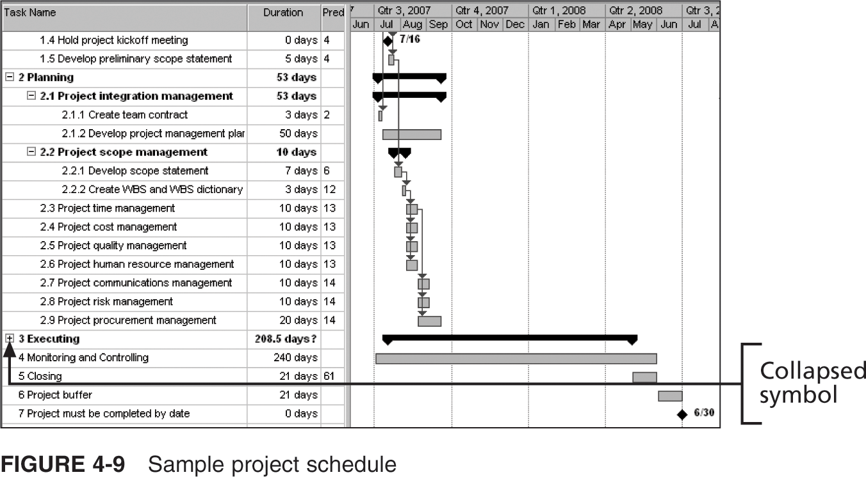
Sample Project Schedule
ECU Copyright 2015 – CSG 2344 School of Computer and Security Science

Slide 27
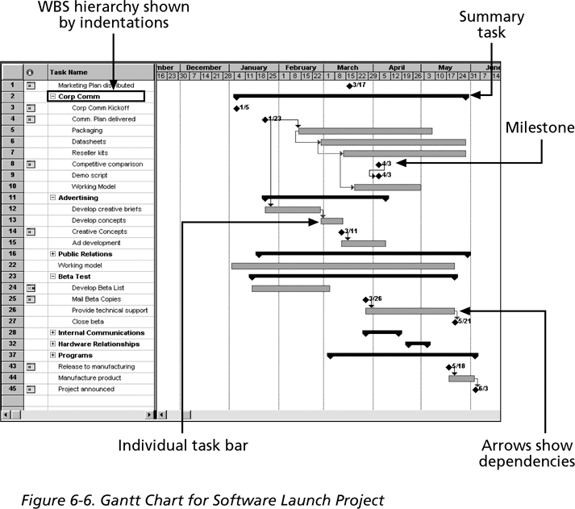
Gantt Chart for Software Launch Project

Slide 28
Adding Milestones
Many people like to focus on meeting milestones, especially for large projects.
Milestones emphasize important events or accomplishments in projects.
You typically create a milestone by entering tasks that have a zero duration, or you can mark any task as a milestone.
ECU Copyright 2015 – CSG 2344 School of Computer and Security Science

Slide 29
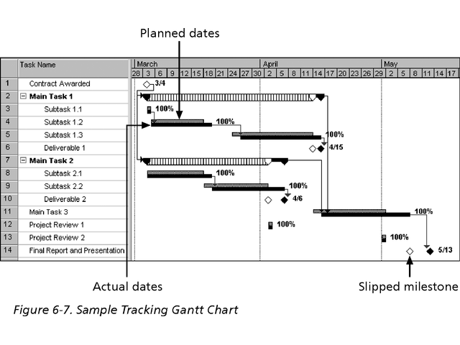
Sample Tracking Gantt Chart

Slide 30
Critical Path Analysis
Critical path method (CPM)—also called critical path analysis—is a network diagramming technique used to predict total project duration.
A critical path for a project is the series of activities that determine the earliest time by which the project can be completed. It is the longest path through the network diagram and has zero slack or float.
  Slack or float is the amount of time an activity may be delayed without delaying a succeeding activity or the project finish date.
The longest path or the path containing the critical tasks is what is driving the completion date for the project.

Slide 31
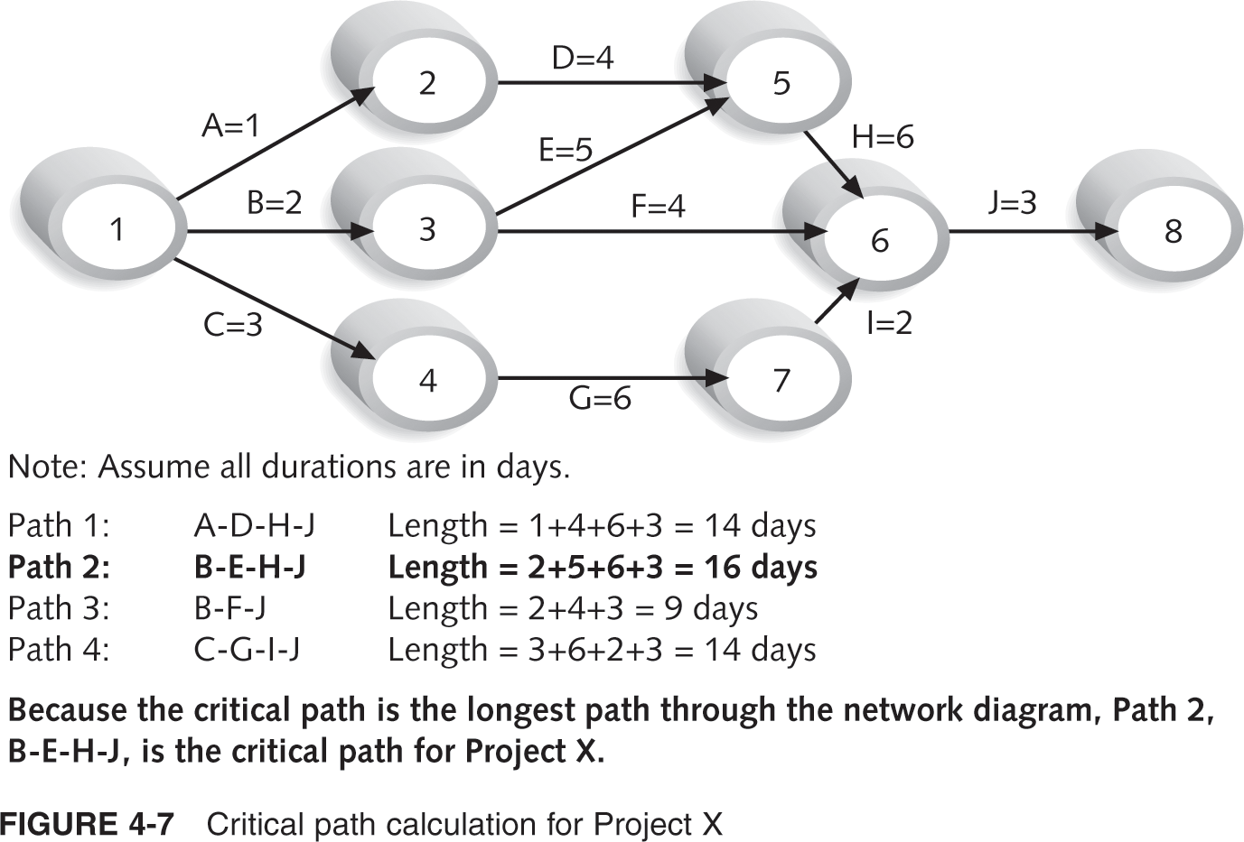
Figure 4-7. Critical Path Calculation for Project X

Slide 32

What Does the Critical Path Really Mean?
The critical path shows the shortest time in which a project can be completed.
If one or more of the activities on the critical path takes longer than planned, the whole project schedule will slip unless the project manager takes corrective action.
Apple Computer team members put a
stuffed gorilla on top of the cubicle of
whoever was in charge of a critical task,
so they would not distract him or her.

Slide 33
More on the Critical Path
The critical path does not necessarily contain all the critical activities; it only accounts for time.
There can be more than one critical path if the lengths of two or more paths are the same.
The critical path can change as the project progresses.
ECU Copyright 2015 – CSG 2344 School of Computer and Security Science

Slide 34
Using Critical Path Analysis to Make Schedule Trade-offs
It is important to know what the critical path is throughout the life of a project so that the project manager can make trade-offs.
If one of the tasks on the critical path is behind schedule, should the schedule be renegotiated with stakeholders, or should more resources be allocated to other items on the critical path to make up for that time?
It is also common for project stakeholders to want to shorten project schedule estimates, so you need to know what tasks are on the critical path.
ECU Copyright 2015 – CSG 2344 School of Computer and Security Science

Slide 35
Schedule Compression Techniques
Crashing is a technique for making cost and schedule trade-offs to obtain the greatest amount of schedule compression for the least incremental cost.
  If two critical tasks each take two weeks, and it will take $100 to shorten Task 1 by a week and $1,000 to shorten Task 2 by a week, shorten Task 1.
Fast tracking involves doing activities in parallel that you would normally do in sequence.
  Instead of waiting for Task 1 to be totally finished before starting Task 2, start Task 2 when Task 1 is halfway done.
Schedule compression often backfires by causing cost, human resource, and quality problems, which lead to even longer schedules.
ECU Copyright 2015 – CSG 2344 School of Computer and Security Science

Slide 36
Exercise
Work out the minimum time for the ‘making cup of tea’ exercise on BlackBoard
You have five minutes
ECU Copyright 2015 – CSG 2344 School of Computer and Security Science

Slide 37

Summary
Time planning processes and outputs
Estimation techniques
Schedule development
ECU Copyright 2015 – CSG 2344 School of Computer and Security Science

